Slide 1

OOP
Object Oriented Programming
Lecture 5
Lecture 1

Slide 2
Outline
Getter and Setter Functions
Practise Questions

Slide 3
Getter/Setter Functions
Getter functions (or accessor functions) are used to read value of a private member of some class
Setter functions (or mutator functions) are used to modify the value of a private member of some class

Slide 4
Why Use Getter and Setter Functions?
Encapsulation: Protects the data by making private data members inaccessible from outside the class.
Control: Allows you to control how data is accessed and modified.
Basic Structure
Private Data Members: These are the variables you want to protect.
Public Getter and Setter Methods: These methods allow controlled access to the private data.

Slide 5
Class Data and Member Function
Access specifier label public, private, and protected
Function are public and data is private
Data is hidden so that it can be safe from accidental manipulation
Function operates on data are public so they can be accessed from outside the class

Slide 6
Class Data and Member Function
Access specifier label public, private, and protected
Function are public and data is private
Data is hidden so that it can be safe from accidental manipulation
Function operates on data are public so they can be accessed from outside the class

Slide 7

Accessing Class Members

Slide 8
C++ Class Methods
Methods are functions that belongs to the class.
There are two ways to define functions that belongs to a class:
Inside class definition
Outside class definition

Slide 9
Function Inside Class Body
Class ClassName {
....
public:
ReturnType FunctionName() {
....
}
};

Slide 10
Program Example - Inside Class Function (My Notes)
Define a function inside the class, and we name it "myMethod".
Notes:
Task 3 contains the code for this

Slide 11
Program Example - Outside Class Function
To define a function outside the class definition, you have to declare it inside the class and then define it outside of the class. This is done by specifiying the name of the class, followed the scope resolution :: operator, followed by the name of the function:

Slide 12
Program Example - Outside Class Function (My Notes)
Implement the same function but this time outside the class.
Notes:
Task 4 contains the code for this

Slide 13
Adding Parameters
Now your task is to define a class “Car” with a speed() method that takes an integer “maxSpeed” and returns it. In the main function, an object of Car is created, and the speed() method is called with the value 200, which is then printed on the screen.
Notes:
Task 4 contains the code for this

Slide 14
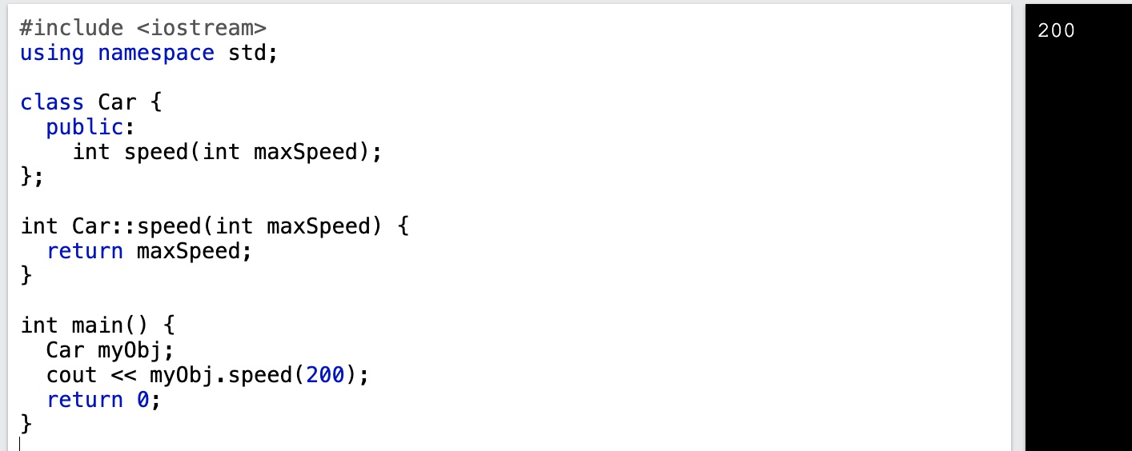
Solution:

Slide 15
End of Lecture

